Slide 1
Introducing COBIT
How COBIT Strengthens IT Governance

Slide 2
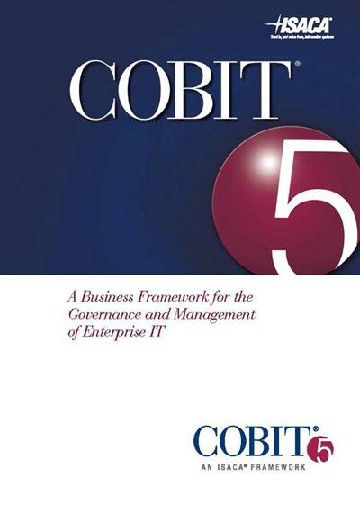
What is COBIT?
Control OBjectives for Information and related Technology
COBIT provides an umbrella framework, bringing together other standards and good practices, and can be adapted to any size organisation. It is both mature and widely recognised.
COBIT helps you understand which functions are supporting your business strategy. It includes a structure, control objectives, and measures to allow you to target innovation where it provides greatest value for money.
Four key features:
Maturity Model
Process Domain
Objective Mapping
Governance Topics
Notes:
* COBIT is a recognised framework, incorporating COBIT into the IT governance internal controls framework supports the 2016/17 business plan for new IT compliance, performance, and policy management systems.

Slide 3
Capability Maturity Model
0
1
2
3
4
5
None
Ad Hoc
Repeatable
Defined
Measured
Optimised
Issue is
not
recognised
Case-by-case approach
Reliance on individual knowledge
Documented procedures with training
Compliance managed
and
actioned
Refined & benchmarked good
practice
Notes:
Maturities – key differences
Errors are likely
Not monitored – processes are unsophisticated
Constant Improvements
Quick to adapt with automation
Key features of COBIT
Maturity Model = how well managed
Process Domain = how well formed
Objective Mapping = how well aligned

Slide 4


Understanding Maturity
Compare the following…
McDonalds
Heston Blumenthal
They both produce radically different products, with different processes and execution
BUT – they both share a focus on mature controls in order to provide a quality product
This makes them reliably consistent – there are “no unwelcome surprises”
Notes:
Heston Blumenthal – The Fat Duck is a 3 star Michelin restaurant. People will travel from around the world to dine here – because they know the standard of food they will experience
McDonalds – People will travel around the world and can enter any McDonalds worldwide and know the standard of food they will experience will be the same.

Slide 5
Four Domains
Plan
Build
Run
Monitor
COBIT Framework covers 4 domains, and 34 processes
Assess Risk
Manage Investment
Manage Changes
Install Solutions
Manage Configuration
Manage Investment
Evaluate Performance
Provide Governance
Notes:
COBIT is a recognised framework, incorporating COBIT into the IT governance internal controls framework supports the 2016/17 business plan for new IT compliance, performance, and policy management systems.
Note: COBIT complements ITIL –Think of it as COBIT says what you should have, ITIL says how you do it.

Slide 6
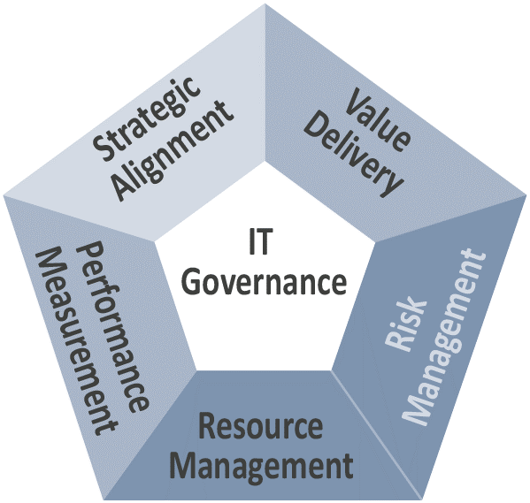
COBIT & IT Governance
COBIT strengthens IT governance by allowing us to evaluate the organisation
to measure how well IT is managed, not just how it is performing.
COBIT ensures excellence in IT Governance by demonstrating that:
  IT is aligned with the business strategy
  IT enables the business and maximises benefits
  IT resources are used responsibly
  IT risks are managed appropriately
  And evidence of appropriate control
Notes:
COBIT can be used like Back Office Benchmarking (BOB), but to compare operation to a wider variety of organisations – it opens the opportunity to work together with organisations outside your immediate market sector to improve – to truly strive to be the best in IT.

Slide 7
COBIT Framework
Hidden Slide – Use if detail required
Control OBjectives for Information and related Technology
ME1 Monitor & evaluate IT performance
ME2 Monitor & evaluate internal controls
ME3 Ensure compliance with external
requirements
ME4 Provide IT governance
Business Objectives
PO1 Define a strategic IT plan
PO2 Define the information architecture
PO3 Determine technological direction
PO4 Define the IT processes, organisation
& relationships
PO5 Manage the IT investment
PO6 Communicate management aims &
direction
PO7 Manage IT human resources
PO8 Manage quality
PO9 Assess and manage IT risks
PO10 Manage projects
IT Resources
Information Criteria
Acquire & Implement
Deliver & Support
Monitor & Evaluate
Plan & Organise
DS1 Define & manage service levels
DS2 Manage 3rd party services
DS3 Manage performance & capacity
DS4 Ensure continuity service
DS5 Ensure systems security
DS6 Identify & allocate costs
DS7 Educate & train users
DS8 Manage service desk & incidents
DS9 Manage the configuration
DS10 Manage problems
DS11 Manage data
DS12 Manage the physical environment
DS13 Manage operations
AI1 Identify automated solutions
AI2 Acquire & maintain application
software
AI3 Acquire & maintain technology
infrastructure
AI4 Enable operation & use
AI5 Acquire IT resources
AI6 Manage changes
AI7 Install and accredit solutions and
changes
Notes:
SUPPORTING SLIDE – DETAIL AS REQUIRED
Management Process: Plan, Build, Run, Monitor
Governance Process: Monitor, Evaluate, Direct (COBIT 5)

Slide 8
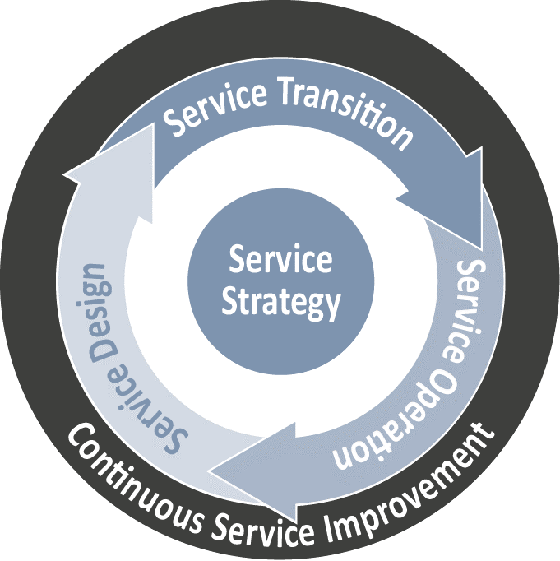
IT Infrastructure Library (ITIL)
Hidden Slide – Use if detail required
SS1 Strategy Management for IT Services
SS2 Service Portfolio Management
SS3 Financial Management for IT Services
SS4 Demand Management
SS5 Business Relationship Management
ST1 Change Management
ST2 Change Evaluation
ST3 Project Management (Transition Planning)
ST4 Application Development
ST5 Release & Deployment Management
ST6 Service Validation & Testing
ST7 Service Asset & Configuration Management
ST8 Knowledge Management
SD1 Design Coordination
SD2 Service Catalogue Management
SD3 Service Level Management
SD4 Risk Management
SD5 Capacity Management
SD6 Availability Management
SD7 IT Service Continuity Management
SD8 Information Security Management
SD9 Compliance Management
SD10 Architecture Management
SD11 Supplier Management
Service Strategy
SO1 Event Management
SO2 Incident Management
SO3 Request Fulfilment
SO4 Access Management
SO5 Problem Management
SO6 IT Operations Controls
SO7 Facilities Management
SO8 Application Management
SO9 Technical Management
CSI1 Service Review
CSI2 Process Evaluation
CSI3 Definition of CSI Initiatives
CSI4 Monitoring of CSI Initiatives
Notes:
SUPPORTING SLIDE – DETAIL AS REQUIRED

Slide 9
CISM Framework
Hidden Slide – Use if detail required
Certified Information Security Manager
G1 Establish an IS strategy
G2 Establish an IS governance framework
G3 Integrate IS governance with corporate gov
G4 Establish IS policies
G5 Develop business case for IS investments
G6 Identify internal/external influences
G7 Obtain top management commitment
G8 Define & communicate roles & responsibilities
G9 Establish & report metrics: KGIs, KPIs, KRIs
RM1 Establish process for asset classification
RM2 Identify requirements for acceptable risk
RM3 Conduct risk, vulnerability and threat reviews
RM4 Determine appropriate risk treatment options
RM5 Evaluate IS controls for effectiveness
RM6 Identify gap between current/desired risk
RM7 Integrate IS RM into business & IT RM
RM8 Monitor existing risk for changes
RM9 Report non-compliance and changes in risk
Governance
Risk & Compliance
Program Development
Incident Management
IM1 Establish incident severity hierarchy
IM2 Establish an incident response plan
IM3 Develop processes for timely identification
IM4 Establish processes to investigate and document
incidents within identified requirements
IM5 Establish escalation & notification processes
IM6 Organize, train & equip teams to respond
IM7 Test and review plan periodically
IM8 Establish communication plans internal/external
IM9 Conduct post-incident reviews for root cause
IM10 Integrate IS plan with DR plan and BC Plan
PD1 Establish IS program aligned to IS strategy
PD2 Align IS program with other functions (e.g. HR)
PD3 Acquire IS resources
PD4 Establish IS architectures (people/process/tech)
PD5 Establish IS standards and compliance docs
PD6 Establish an IS awareness program
PD7 Integrate IS requirements into org processes
PD8 Integrate IS requirements into contracts
PD9 Establish & report operational metrics
Notes:
SUPPORTING SLIDE – DETAIL AS REQUIRED

